Slide 1

Field Research
In order to verify the accuracy of the ratings, Maggie flew to Portugal to taste some of the wines from our data set.
The Vinha Grande Branco, a Portuguese white from the Casa Ferreirinha winery received a 90 point rating according to our data.
Maggie verified the price and agrees with the rating.

Slide 2
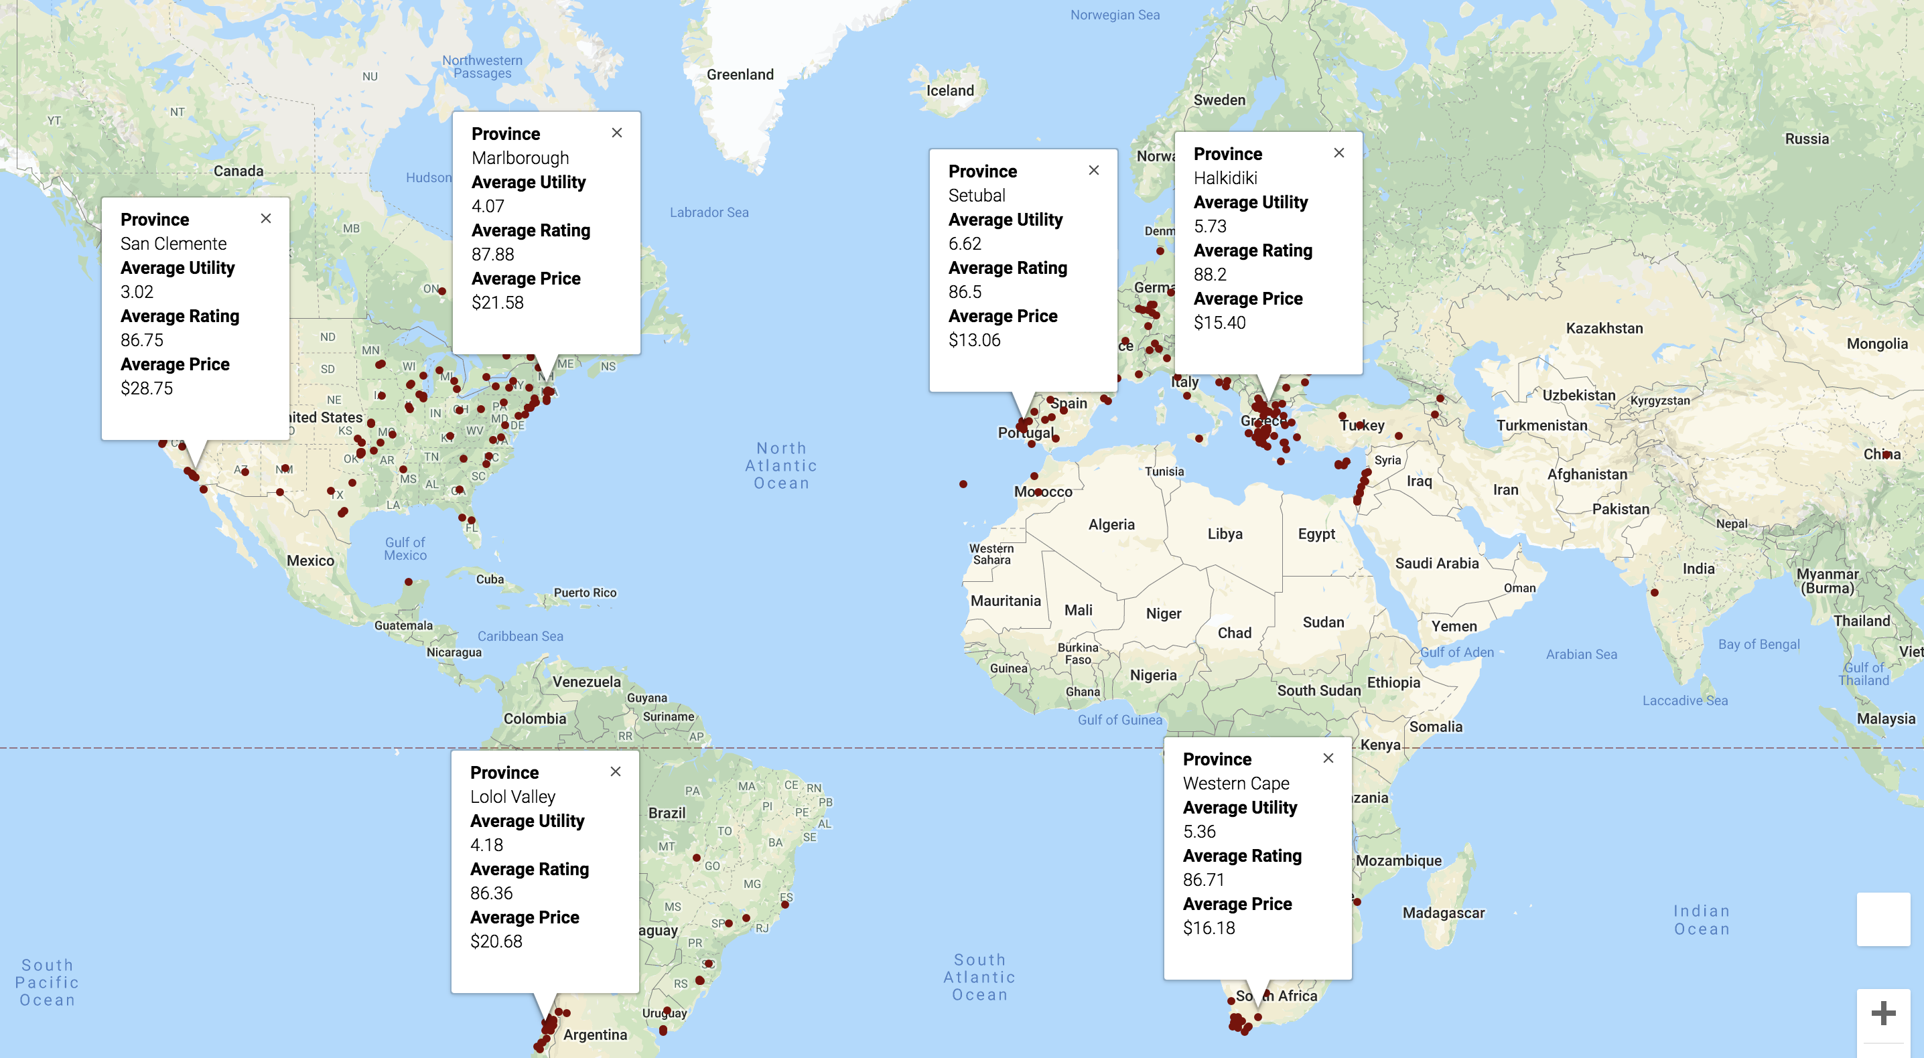
Provincial Overview
Used gmaps to provide insight into regional trends in price, rating, and “utility” by province.
Asian countries (with the exception of China) were not really represented in the data—this is because wine is not widely produced there.
Most of the world’s wines come from Europe, South Africa, New Zealand, South America and the US.

Slide 3
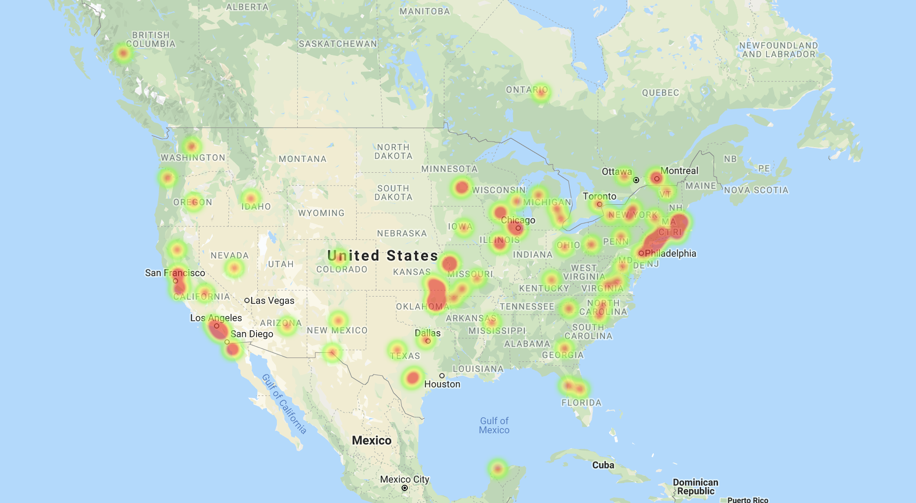
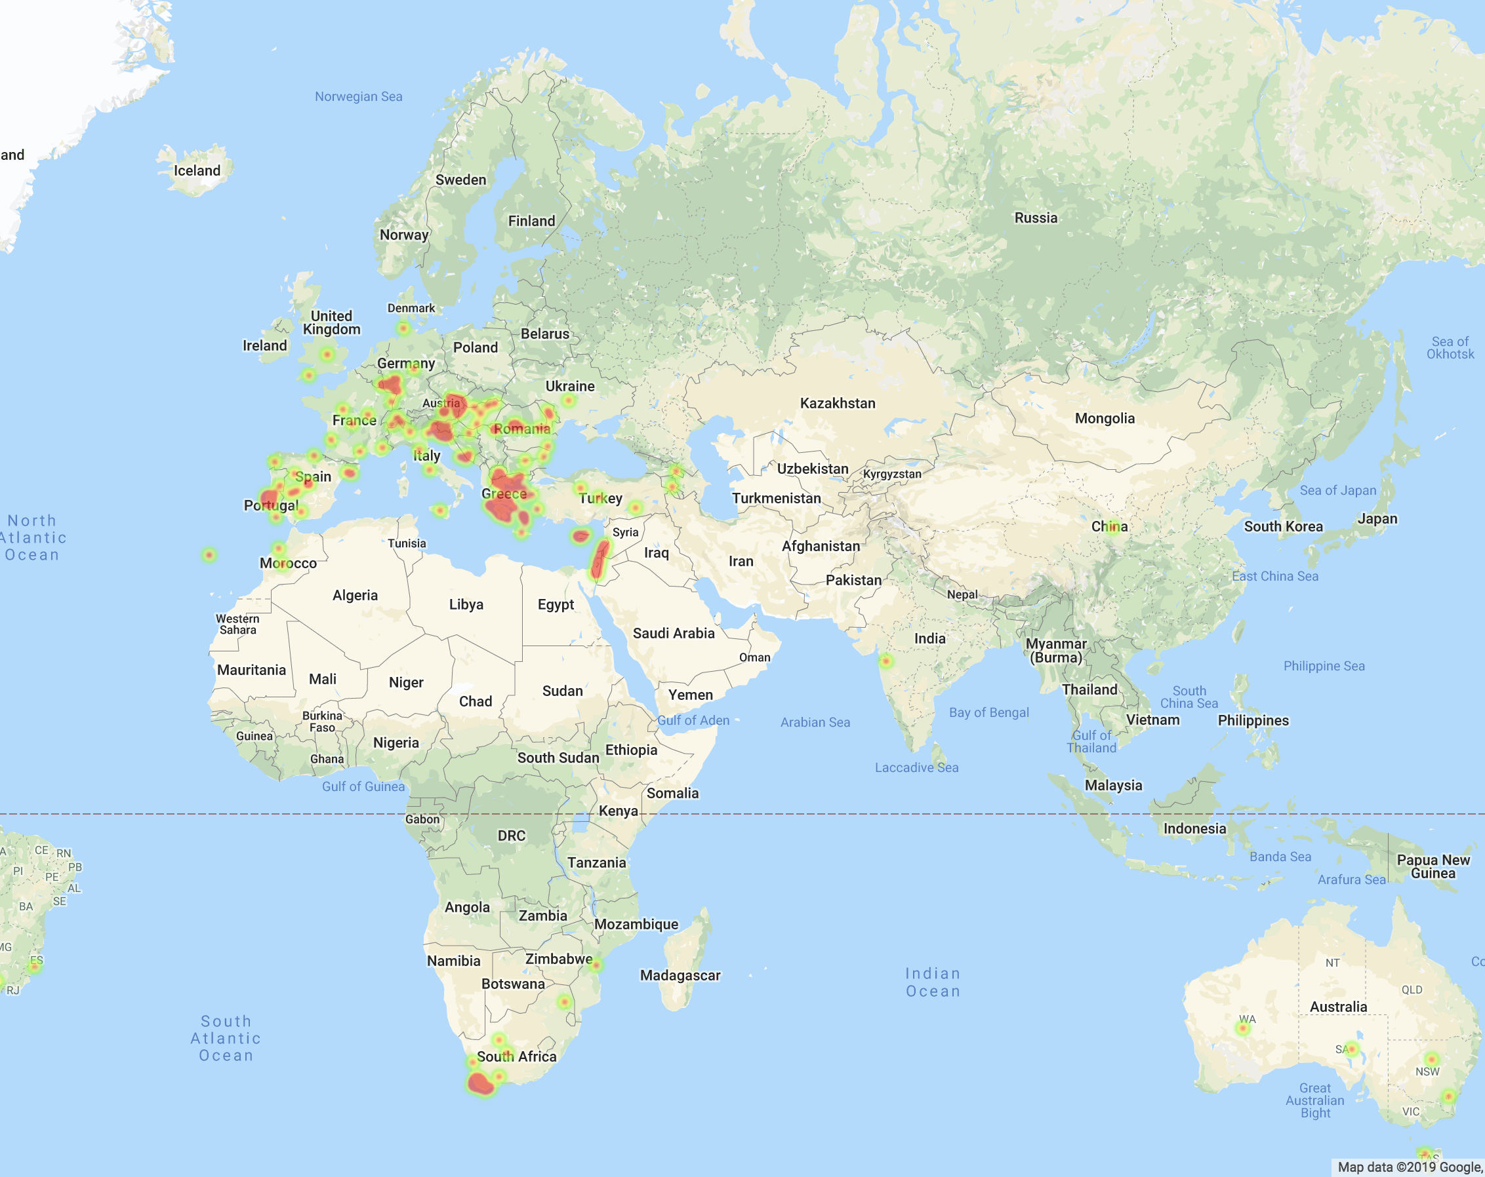
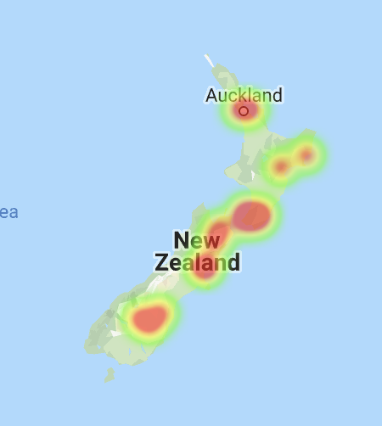
Heatmaps: Average Rating by Province
In the US, wines produced on the East Coast received a higher rating on average than those in California.
Despite its generally tropical climate, Hawaii produces wine (off-dry, fruity whites)
New Zealand, South Africa, Greece, Italy, Chile, and Portugal had the highest ratings of the countries in our data set. This coincides with the top wine producing countries (by volume) as listed by the Food and Agriculture Organization of the United Nations.

Slide 4
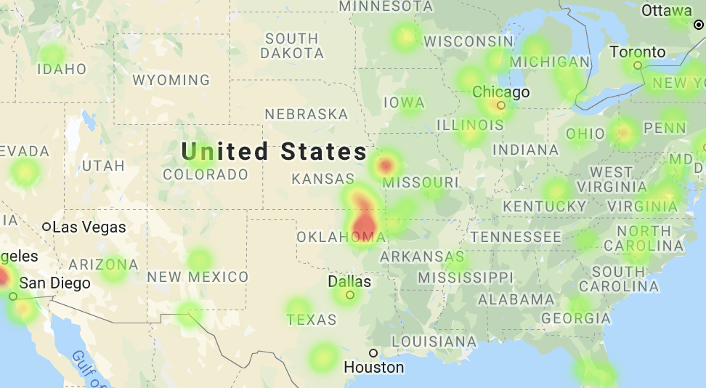
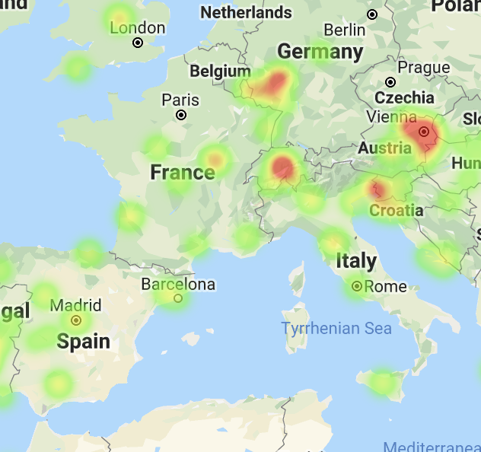
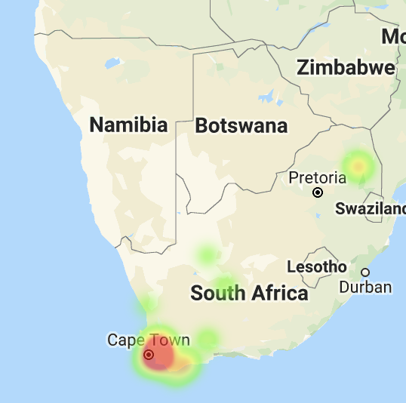
Heatmaps: Average Price by Province
There appears to be no correlation between price and ratings.
The Midwest/South East area of the US had poorly rated wines at a low price, which is what we would expect.
However, Italy, France, and Spain also had some of the lowest average prices despite also having some of the highest average ratings.
South Africa and Switzerland had some of the most expensive wines on average of the provinces in the dataset.

Slide 5
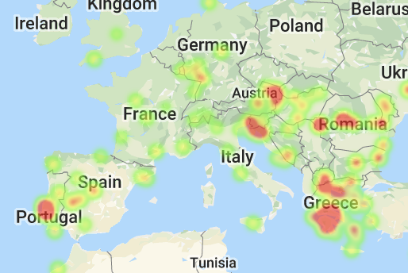
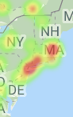
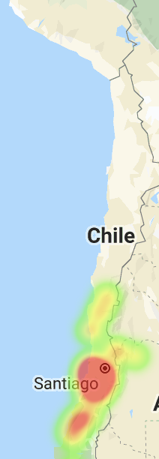
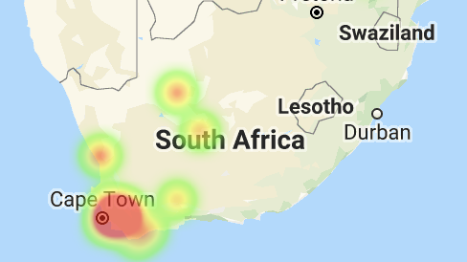
Heatmaps: Average Utility by Province
We defined the utility of each wine as the points per dollar to help us determine the best bang for your buck.
In Europe, the wines with the highest average utility rating are those from Greece, Portugal, Croatia, Romania, and Austria. Italy and France surprisingly fell short.
Wines from South Africa, Chile, and the East Coast of the US also received high utility ratings, with California following closely behind.

